Slide 1
Athena - Smart Campus
Team CSEBNUM_ACS_C
221710303016 - Guntuku Chaitanya
221710303022 - Ketaki Kashtikar
221710303023 - Ketha Divya Sree
Project Guide - Prof.Abhinandhan Banik

Slide 2
Acknowledgements
We would like to express our gratitude to our industry mentor, Mr. Raja Shekhar who is guiding us through this project.
We would also like to thank Mr.Ravi Shankar who has been a constant support, encouraging us to do better and improve.
We convey our sincere regard to our project mentor Mr. Abhinandhan and our project coordinator Dr. Aparna.

Slide 3
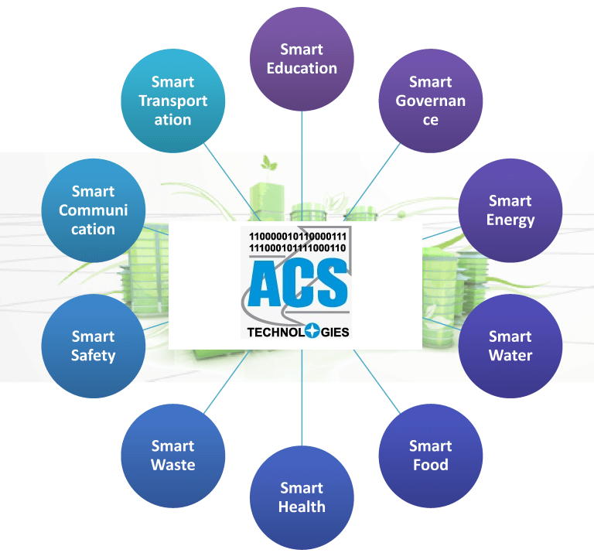
About our Project
In this epoch of technology, automation, where the internet has a salient role, replaces manual systems to make human life simpler. The foundation to this project is the Internet of Things(IoT) offering control over connected devices across a network infrastructure.
Aim of our Project:-
The entire system development as Smart Buildings , Smart Energy and Smart Safety , focussing on to develop each and every entity within campuses.

Slide 4
Key focus area of research and innovation
Smart Health and Safety

Slide 5
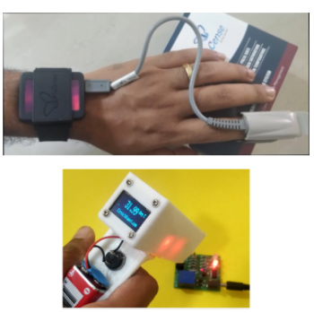

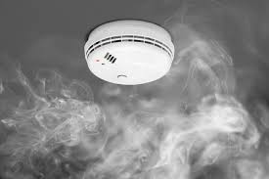


Slide 6
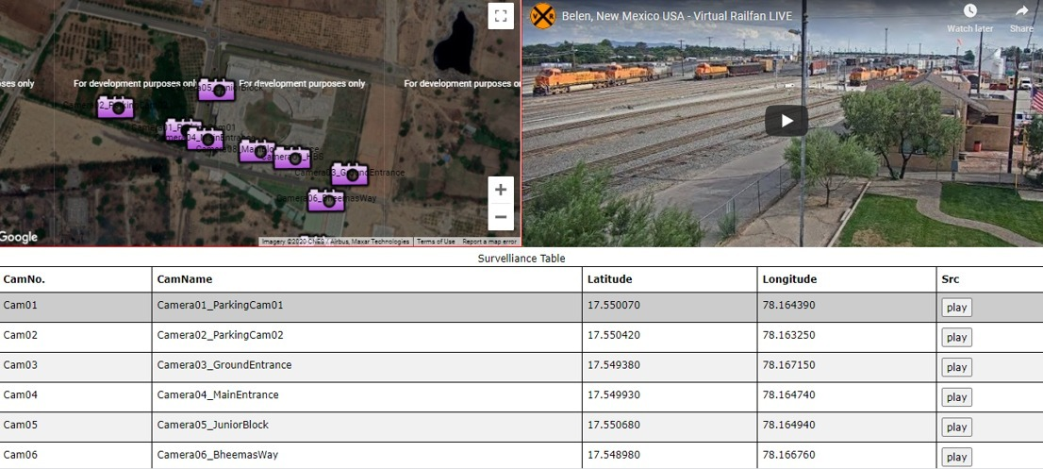
Previous Work
Smart Surveillance System

Slide 7
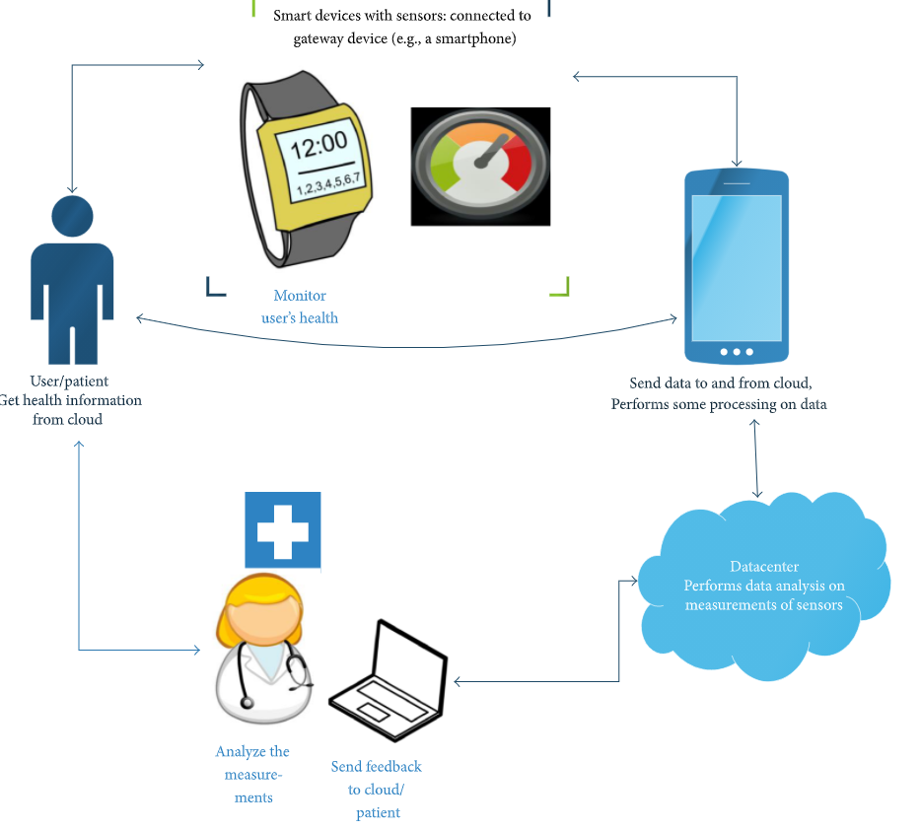
Smart Health Monitoring
Aim of the proposed system:-
To build preventive and early detection automated systems with health integrated sensors and software applications that are not medical grade, but an excellent alternative

Slide 8


